Slide 1
Which Phylum Game?

Slide 2
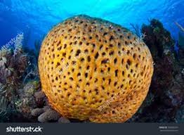
Question 1

Slide 3
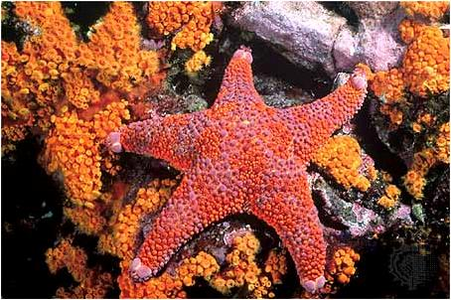
Question 2

Slide 4
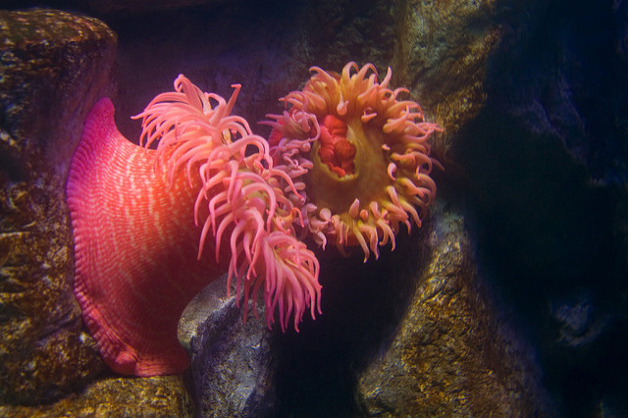
Question 3

Slide 5
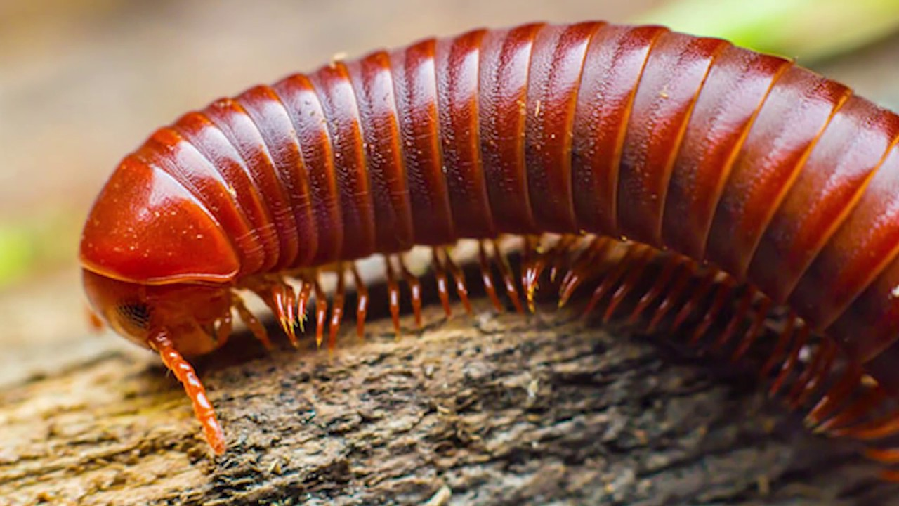
Question 4

Slide 6
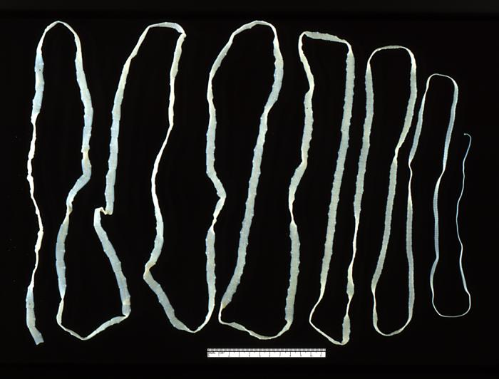
Question 5

Slide 7
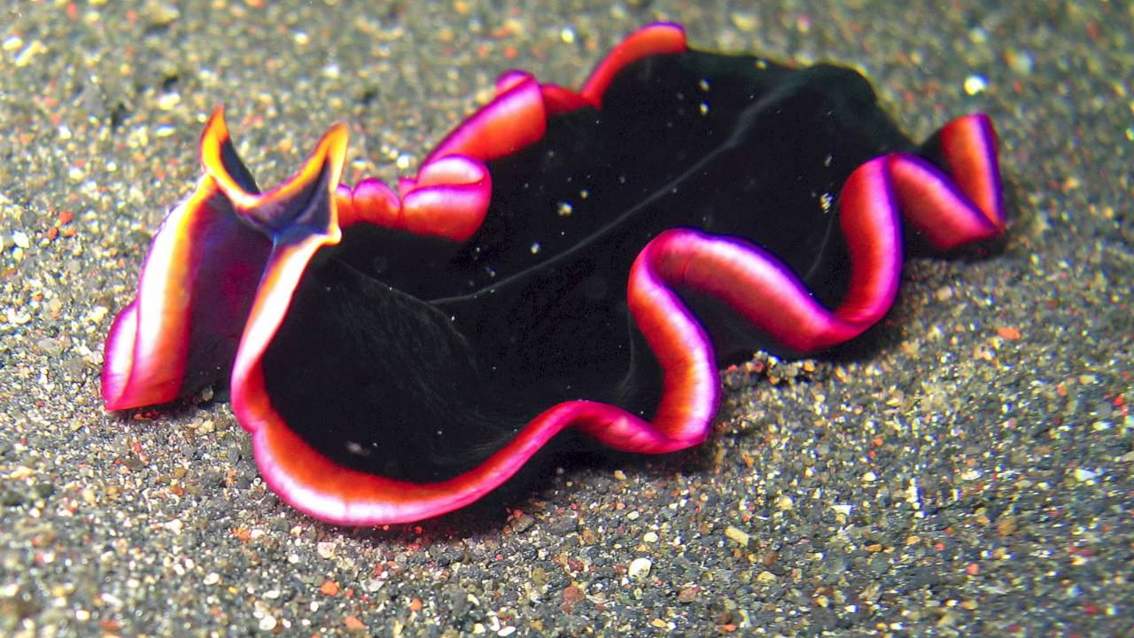
Question 6

Slide 8
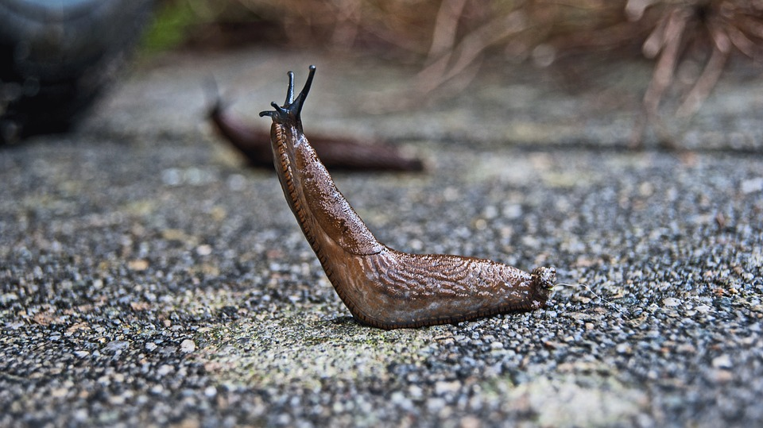
Question 7

Slide 9
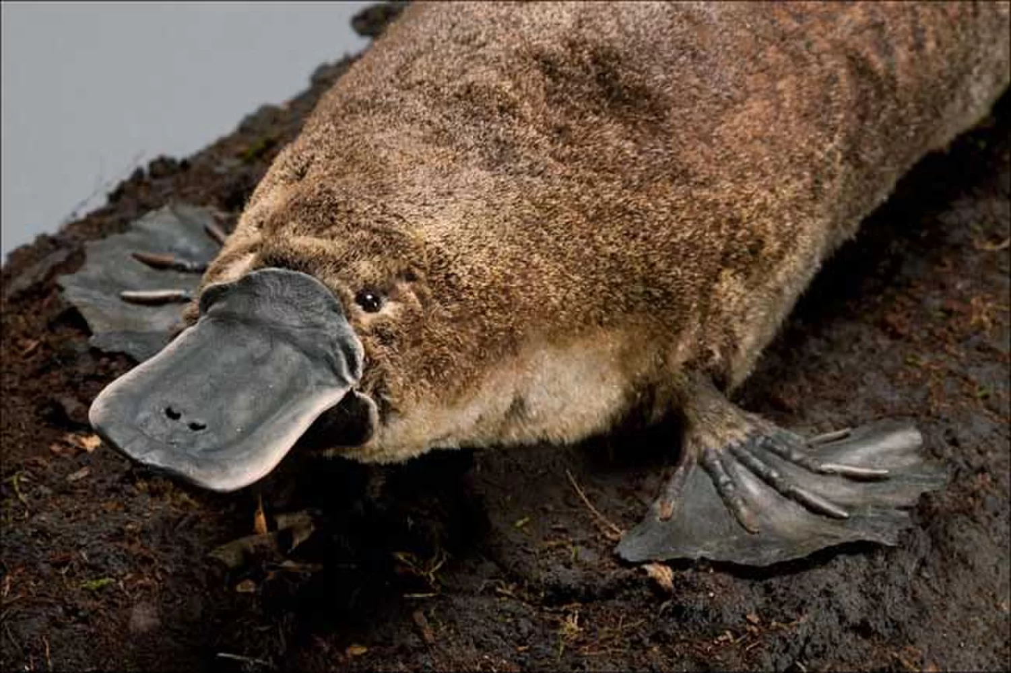
Question 8

Slide 10
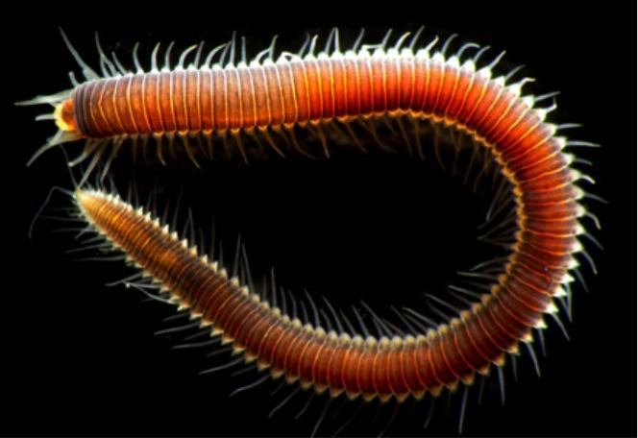
Question 9

Slide 11
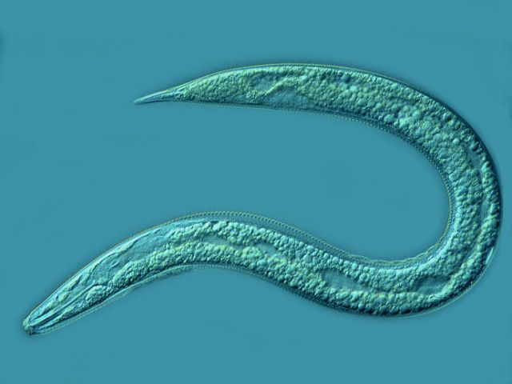
Question 10

Slide 12
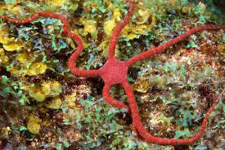
Question 11

Slide 13

Question 12

Slide 14

Question 13

Slide 15

Question 14

Slide 16
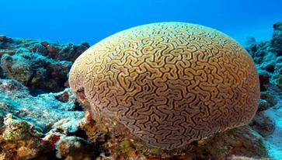
Question 15

Slide 17
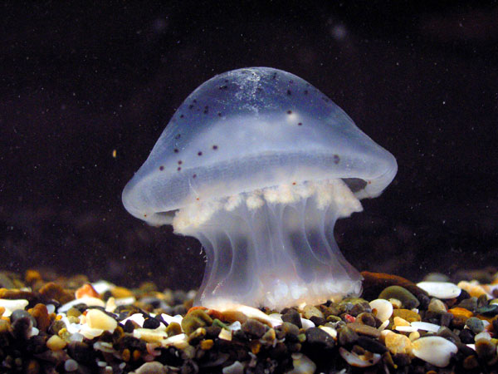
Question 16

Slide 18
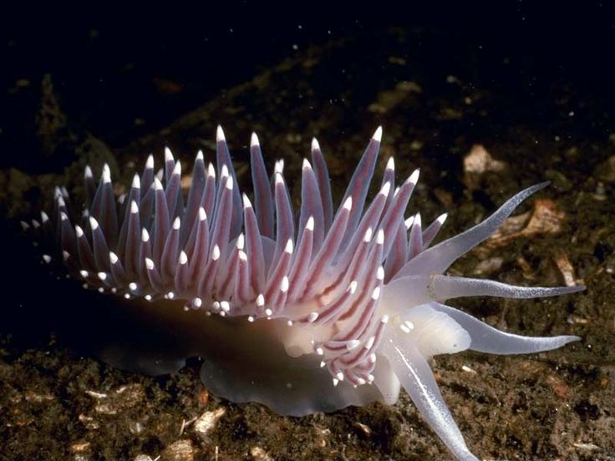
Question 17

Slide 19
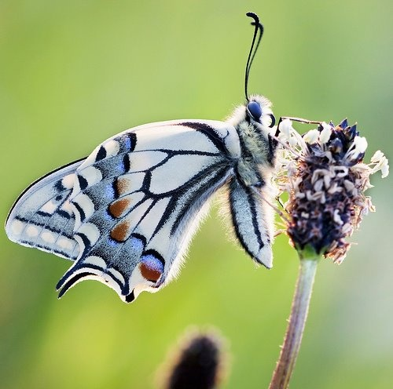
Question 18

Slide 20
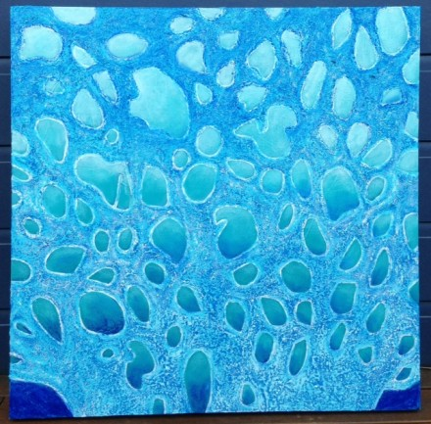
Question 19

Slide 21
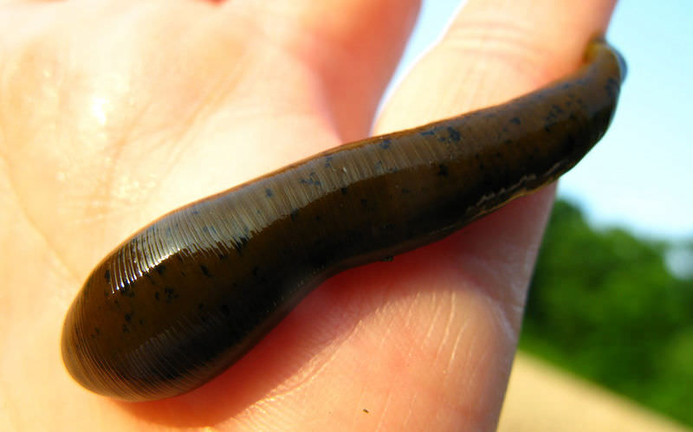
Question 20

Slide 22
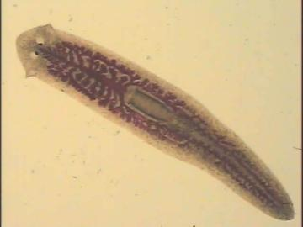
Question 21

Slide 23
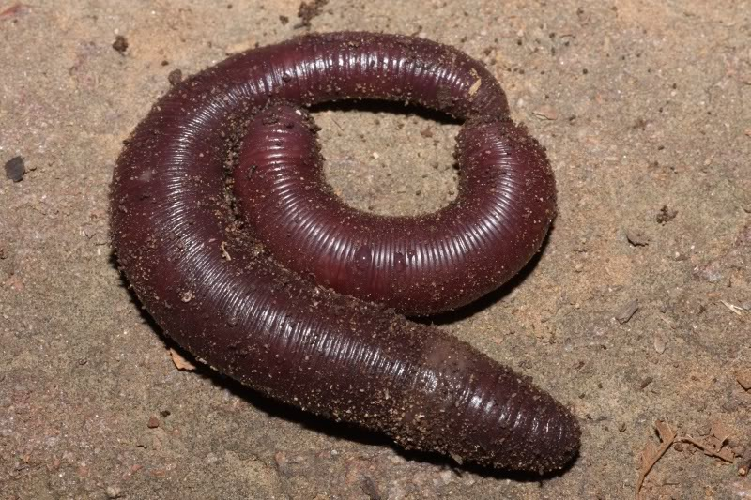
Question 22

Slide 24
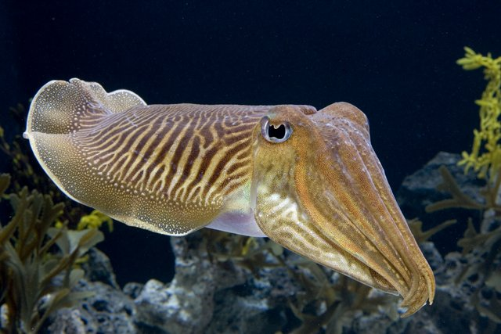
Question 23

Slide 25
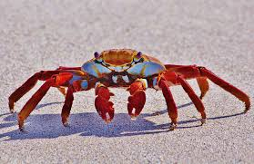
Question 24

Slide 26
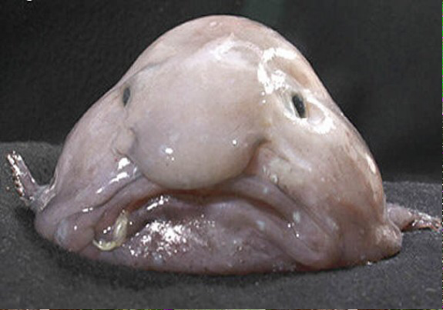
Question 25

Slide 27
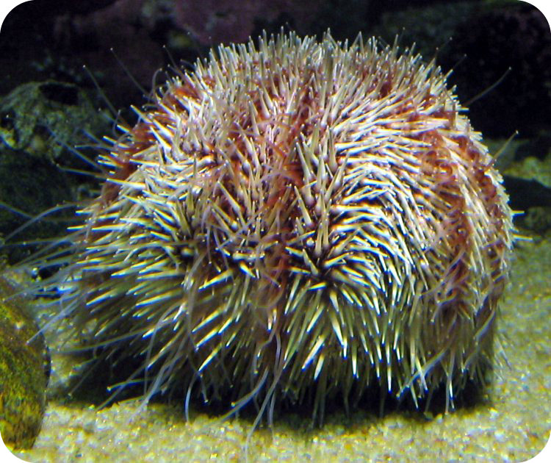
Question 26

Slide 28
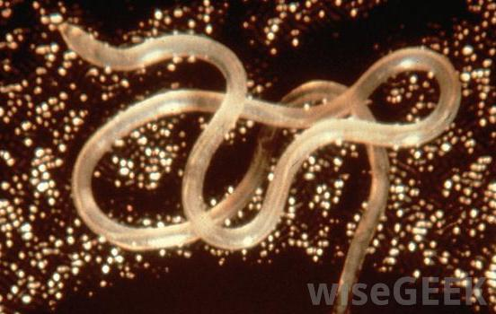
Question 27

Slide 29
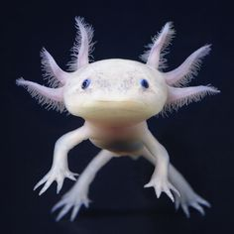
Quesiton 28

Slide 30
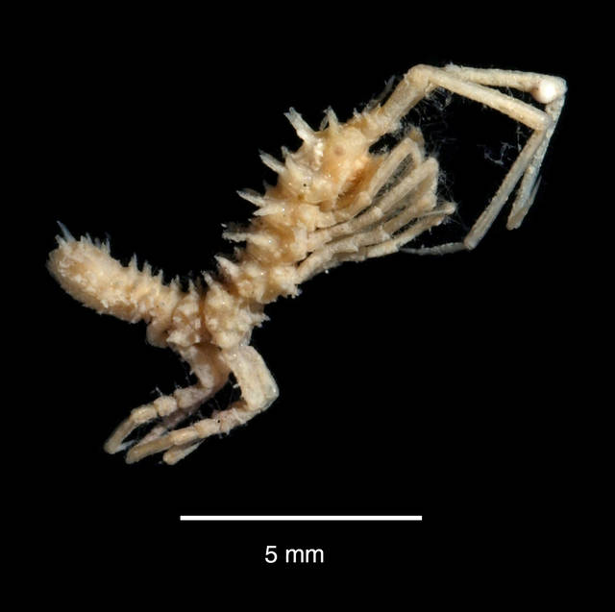
Question 29

Slide 31
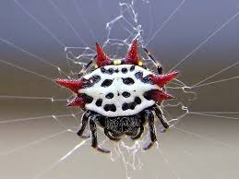
Question 30

Slide 32
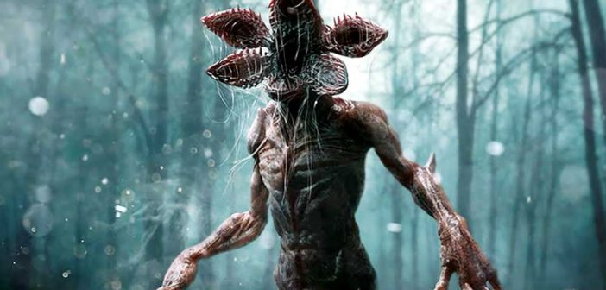
Demogorgon

Slide 33


Xenomorph

Slide 34

Sponge Bob

Slide 35
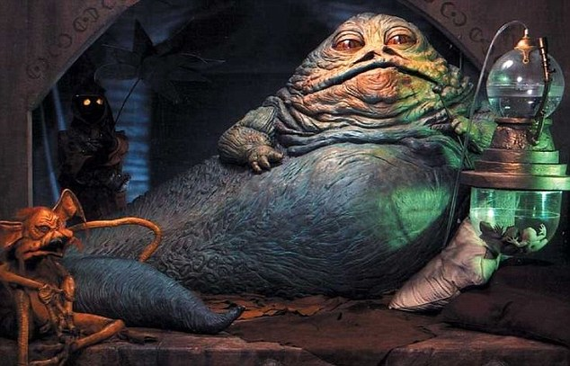
Jabba the Hutt

Slide 36

Mini Moose

Slide 37

Nyarlathotep

Slide 38
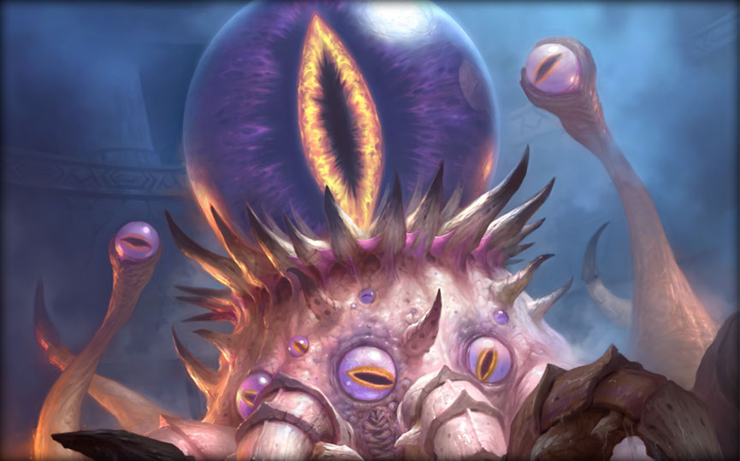
C’thun

Slide 39
Answers
11. Echinoderm
12. Chordata
13. Nematoda
14. Porifera
15. Cnidarian
16. Cnidarian
17. Mollusca
18. Arthopoda
19. Porifera
20. Annelida
21. Platyhelminth
22. Annelida
23. Mollusca
24. Arthopoda
25. Chordata
26. Echinoderm
27. Nematoda
28. Chordata
29. Arthopoda
30. Arthopoda
Porifera
Echinodermata
Cnidarian
Arthopoda
Platyhelminthes
Platyhelminthes
Mollusca
Chordata
Annelida
Nematoda

